Slide 1
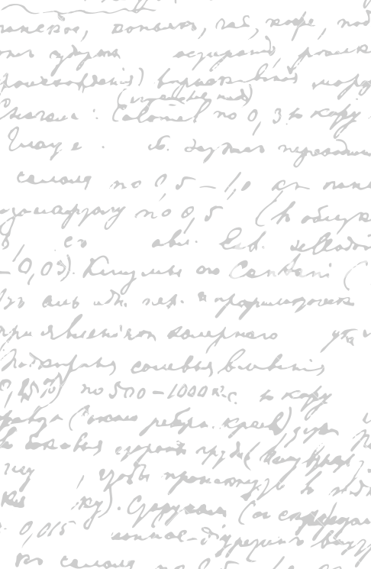

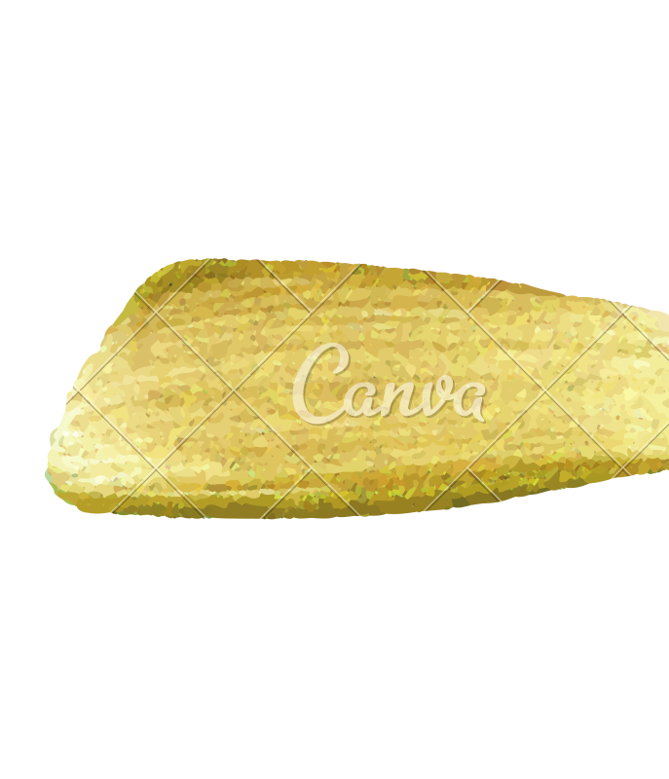

Ming Wu (Andrew) 2133861w
Laser Mate!
Project Supervisor Meeting 11
29 January 2021

Slide 2
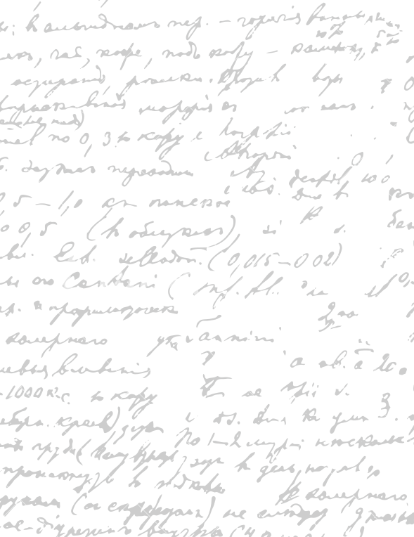



Start Recording

Slide 3
Main Topics
Evaluate dissertation parts
Evaluate digital prototype

Slide 4
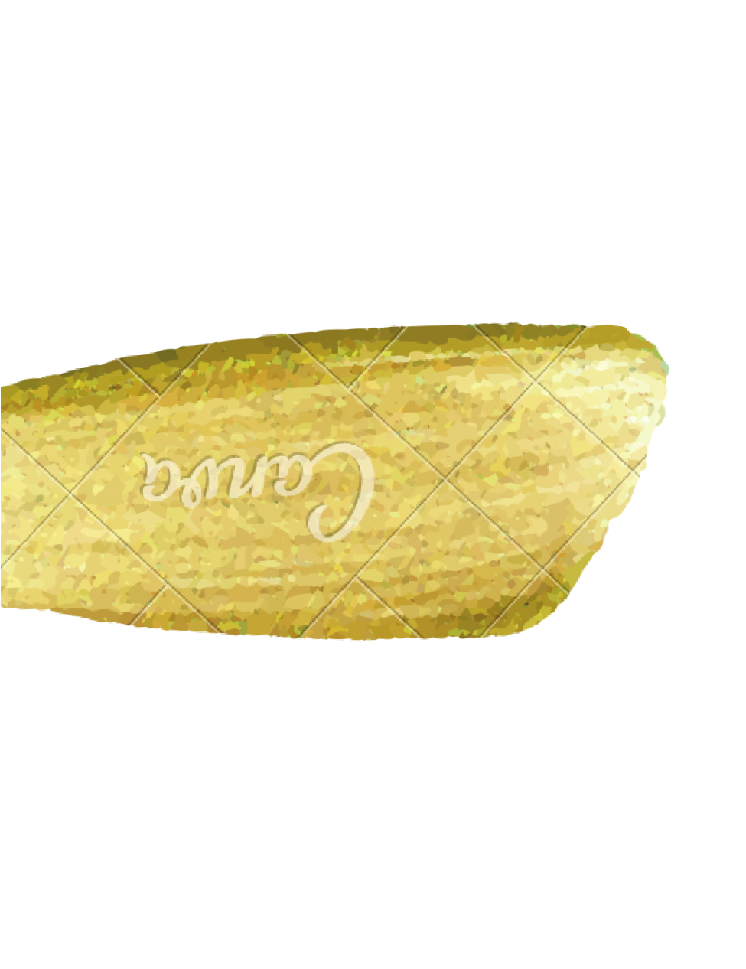
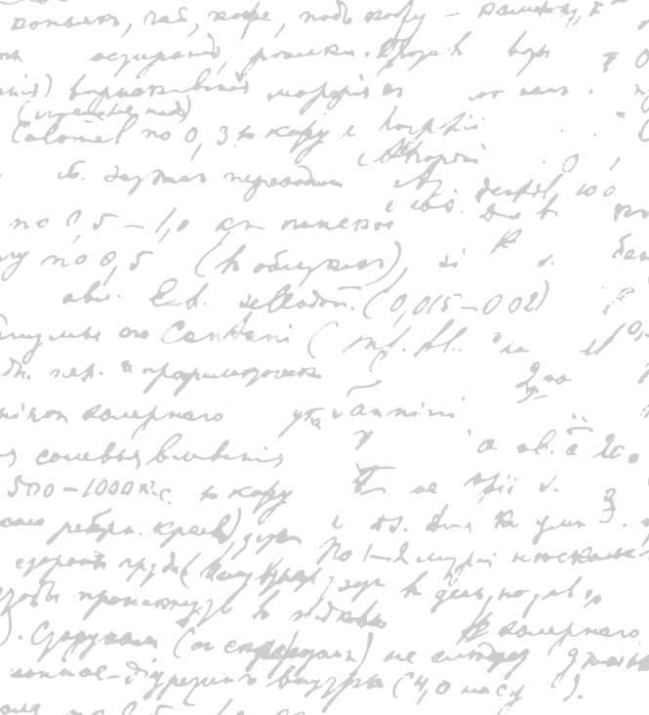

Evaluate Dissertation
Parts
Workflow
User Stories & Acceptance Criteria
Dissertation from the start

Slide 5
2. Evaluate and Refine Current
Digital Prototype
For each software part,
- describe why it is a good design; suggest areas of improvement, consider alternative designs.
Colour Scheme/ Contrast
Font Size/ Style
Way of presentation (order of information display)
Word Choice/ image
Icon shape/ size
Spacing/ Proximity between words/images
Software process (how to navigate between pages)
Necessity (whether this part must be present)
What can be added and why
What can be deleted and why
What can be improved and how/ identify the solutions

Slide 6
End

